Slide 1
Analyze and Predict Default Risk Based on Financial and Demographic Factors
Nguyen Quynh Lam Nga

Slide 2
Presentation structure
1. Introduction
2. Data Cleaning
Handle missing values and outliers.
Visualization
3. Machine learning models
Logistic Regression
Random Forest
Gradient Boosting
Compare models
4. Results and Insights

Slide 3
1. Introduction
Goals of the Project
The main goal is to build a predictive model to estimate the probability of loan default based on financial and demographic factors
Find out the factors of default
Data Sources Used
The dataset is sourced from Kaggle, specifically the "Loan Default Prediction Dataset."
Data Overview
The dataset includes details about each loan, such as age, income, credit score, and employment information, which are useful in assessing credit risk.
Demographic Group : Age, Education, Employment Type, Marital Status, Has Dependents
Finance Group: Income, Loan Amount, Credit Score, Months Employed, Num Credit Lines, Interest Rate, Loan Term, DTIRatio, Has Mortgage, Loan Purpose, Has Co Signer, Default
Structure

Slide 4
2. Data Cleaning
Libraries
Outliers
Pandas, Numpy, Stasmodels, Matplotlib, Seaborn and Scikit-learn
Income, LoanAmount, CreditScore, Interest Rate, DTI Ratio, Months Employed, Num Credit Lines
Converts data type object to category.
Missing & Duplicated Value

Slide 5
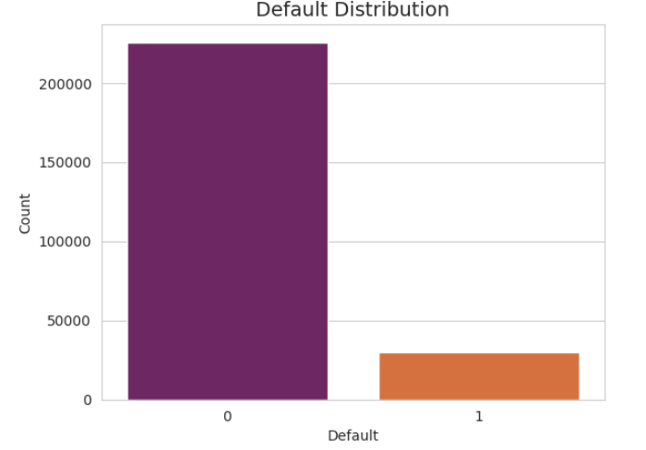
2. Data Cleaning
The number of people who do not default is larger.
Visualization

Slide 6
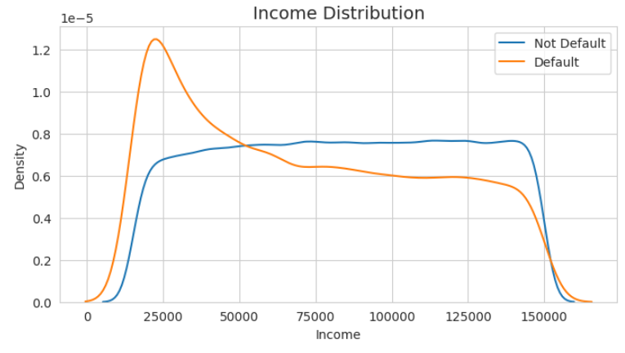
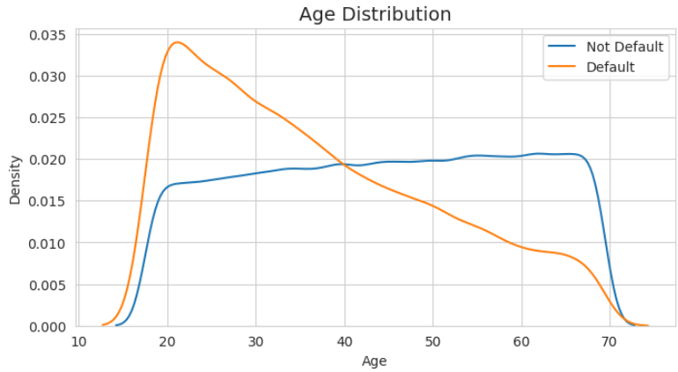
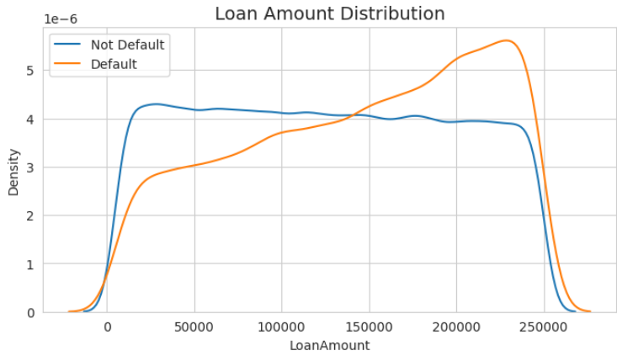
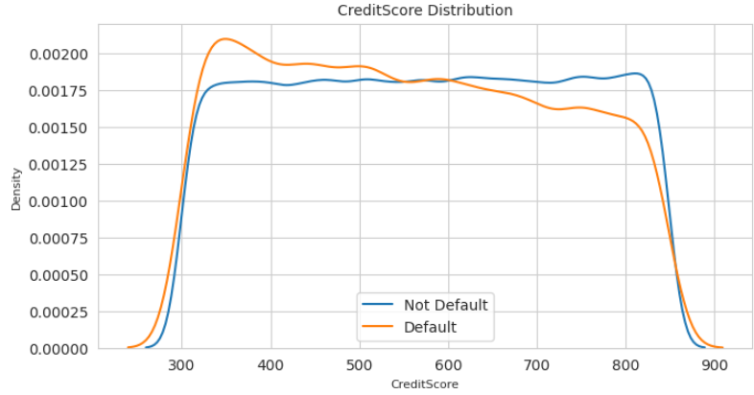

Slide 7
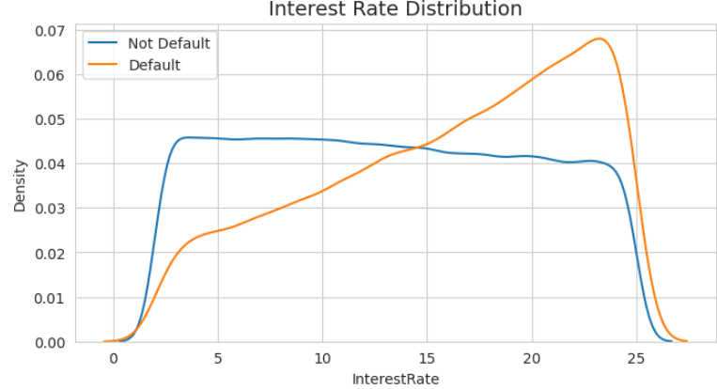
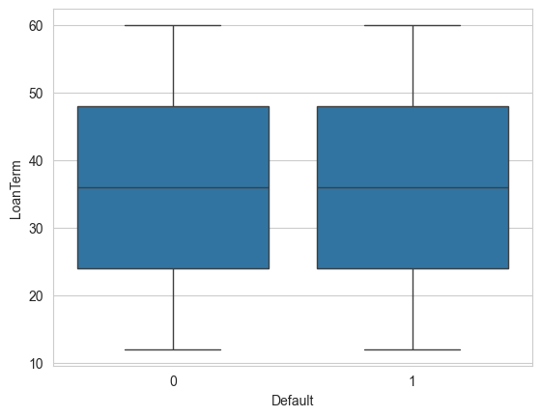
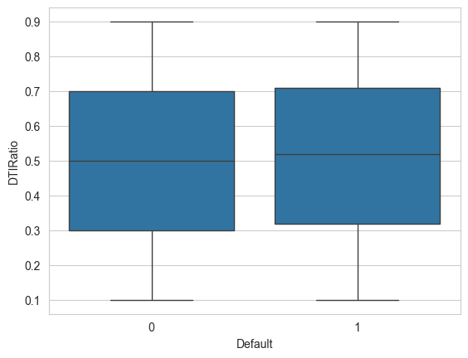
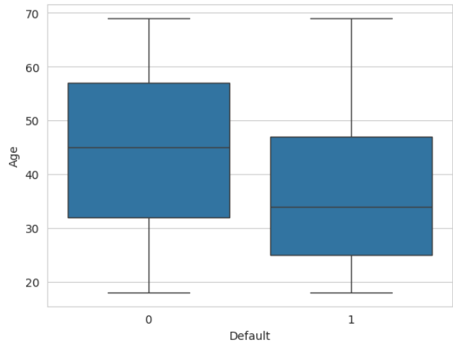

Slide 8
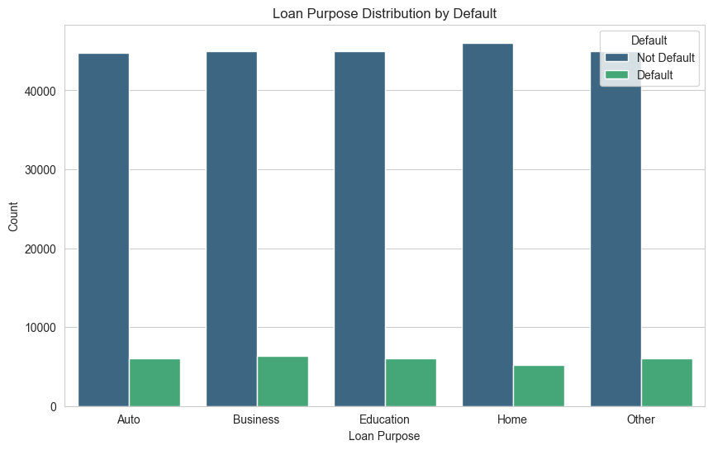
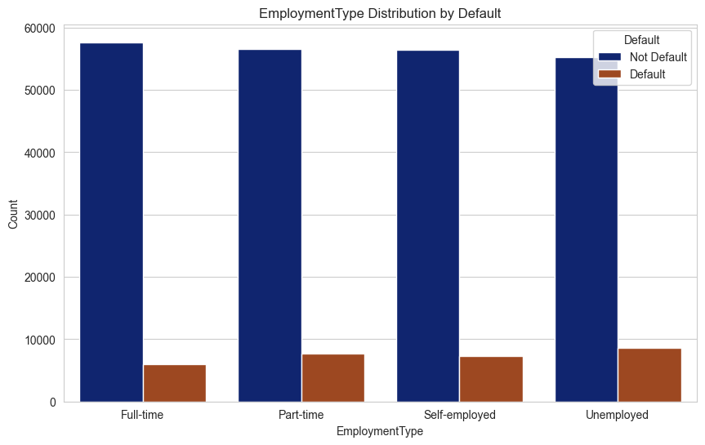
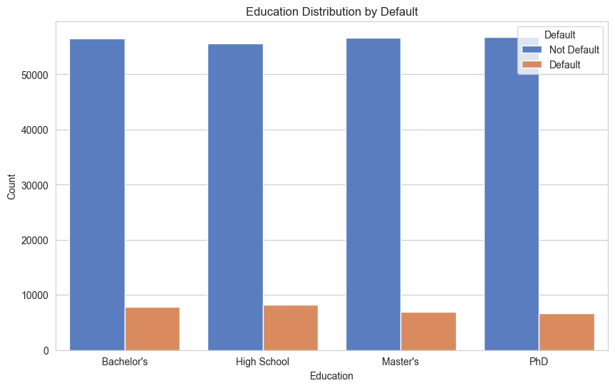
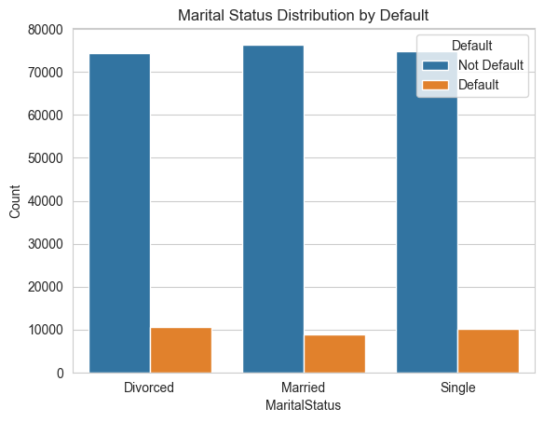

Slide 9
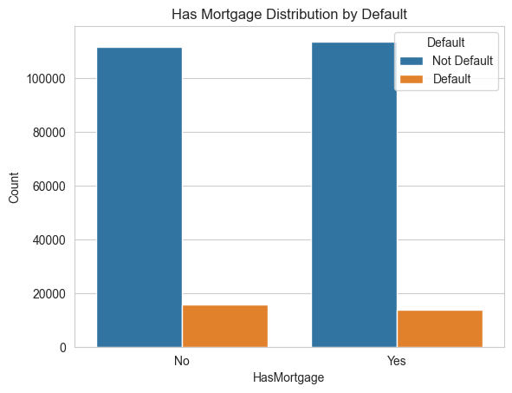


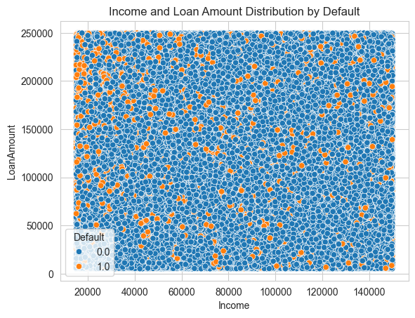

Slide 10
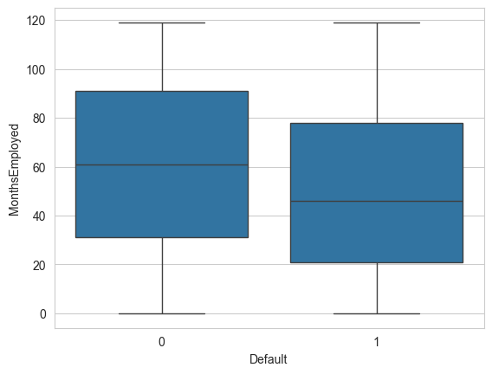
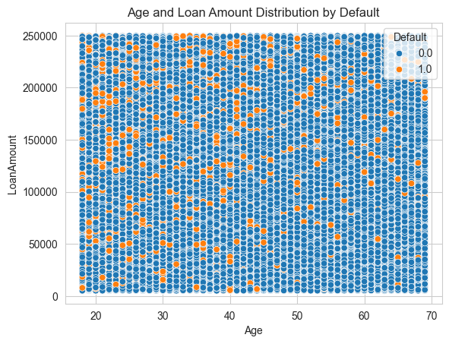
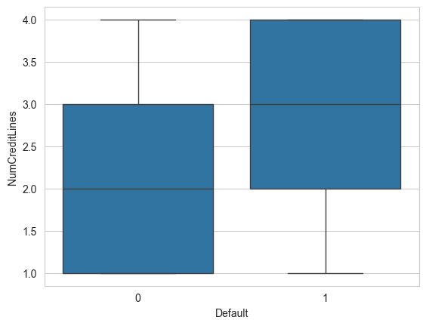

Slide 11
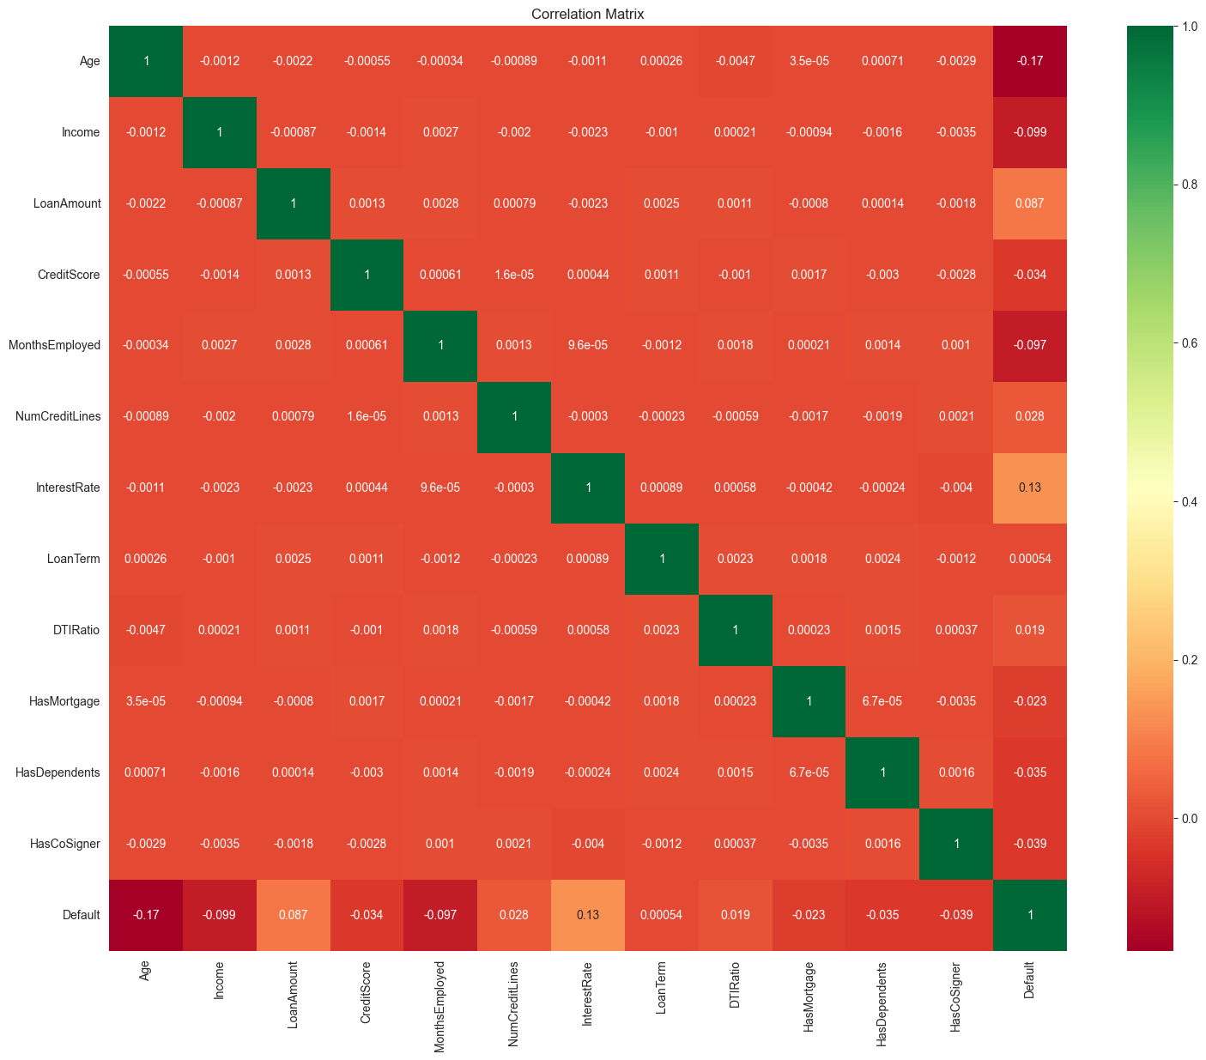
Correlation Matrix

Slide 12
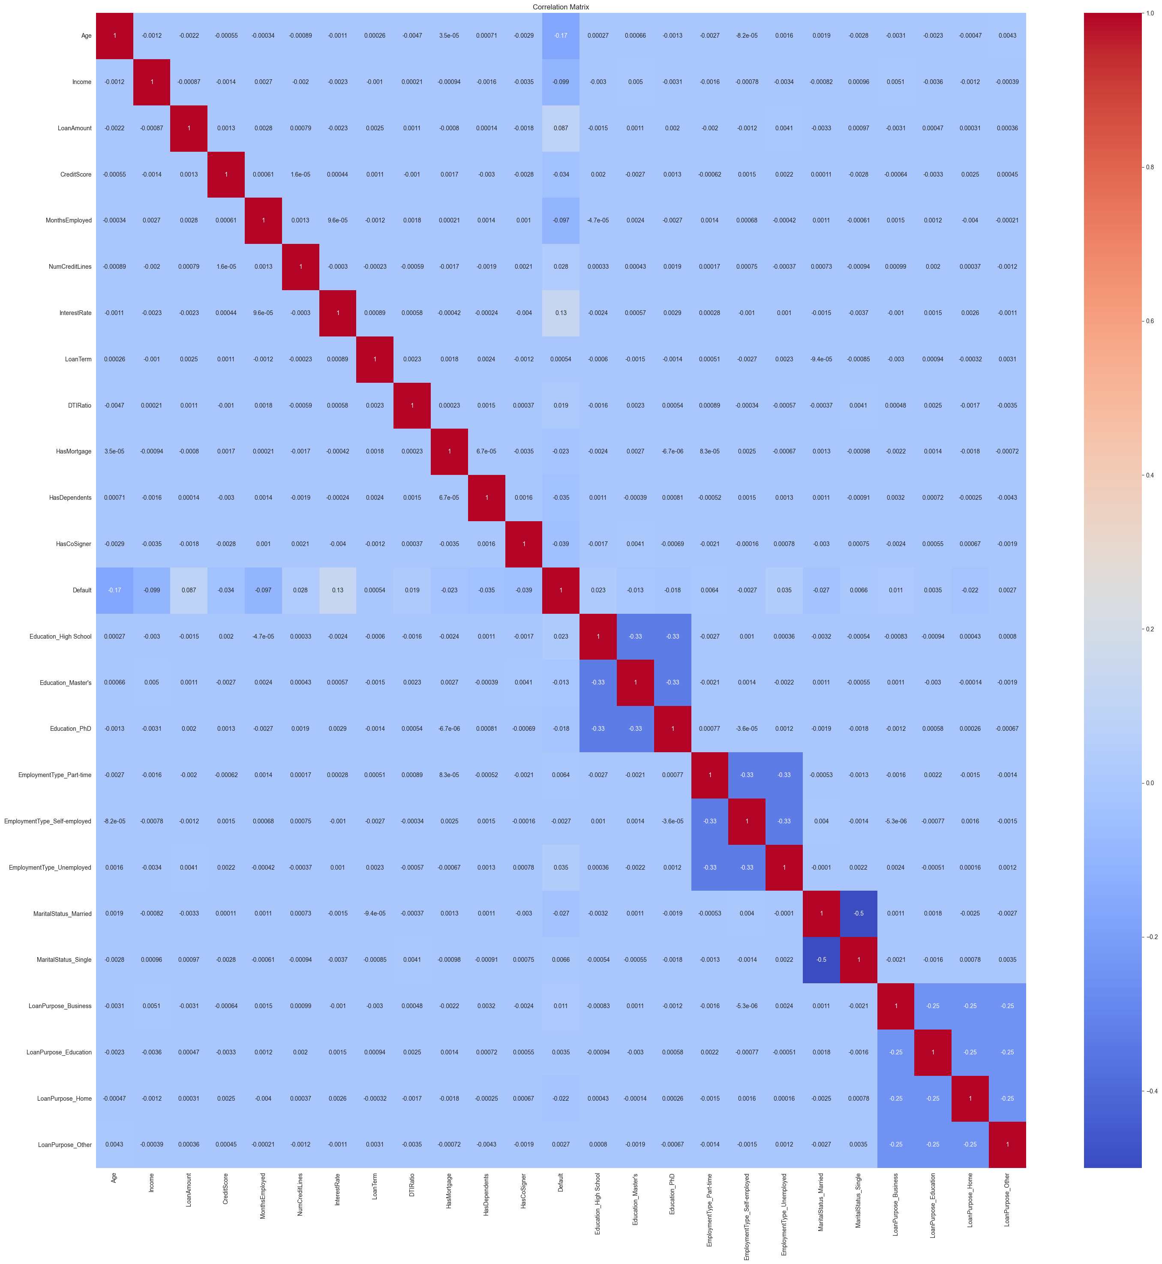
Correlation Matrix
NumCreditLines, LoanTerm, DTIRatio, and some other categorical variables (such as marital status, education) do not have a significant effect on the probability of default.
Variables that are strongly correlated with Default such as InterestRate, Age, Income, and LoanAmount may be important variables in building a predictive model.

Slide 13
3. Machine learning models
Using F1-Score and AUC-ROC
Split the dataset into 2 parts with a ratio of 80-20: 80% of the data will be used to train the model (training set), and the remaining 20% ​​will be used to test the model (testing set).

Slide 14
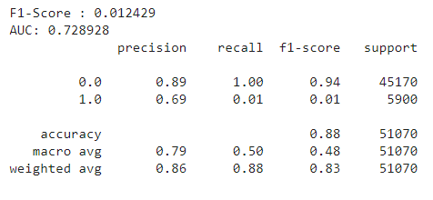
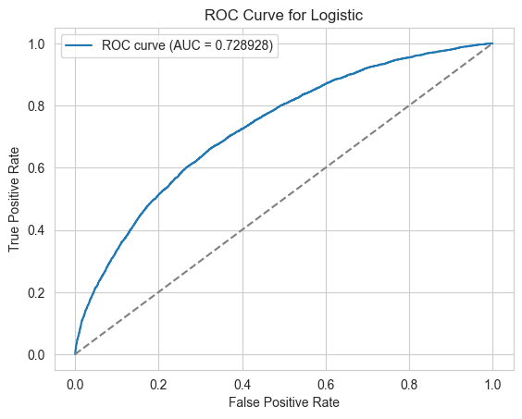
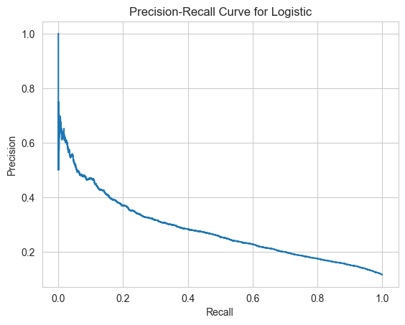
Logistic Regression

Slide 15
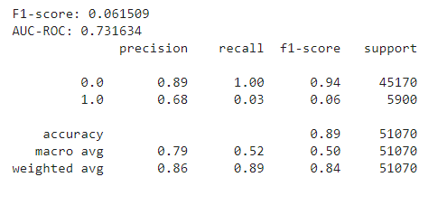
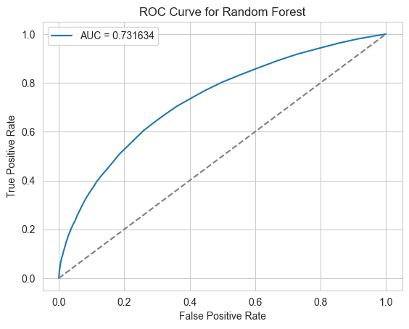
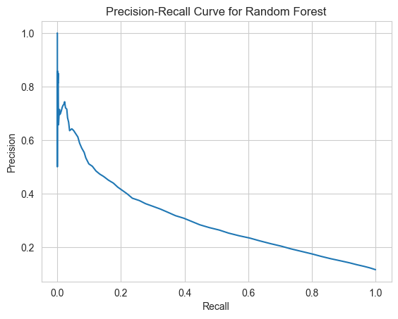
Random Forest

Slide 16
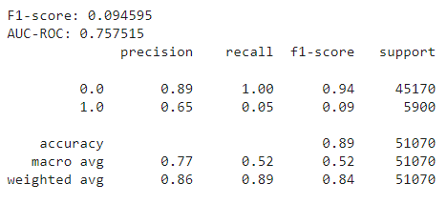
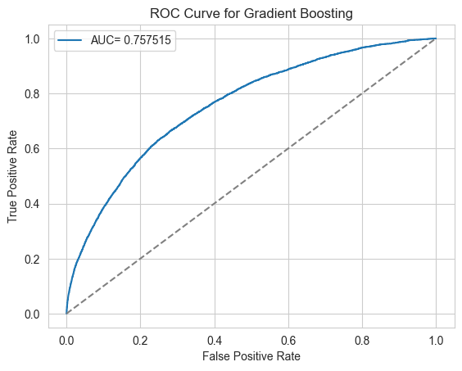
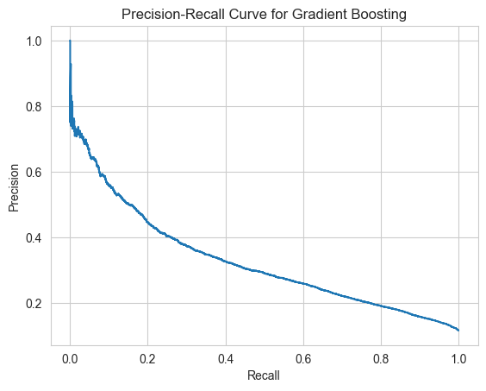
Gradient Boosting

Slide 17
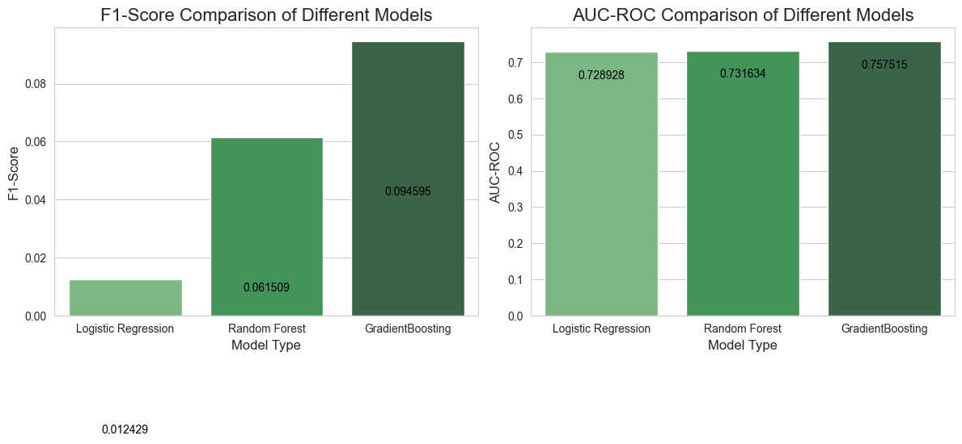
Compare models

Slide 18
4. Results and Insights
Insights
Solution
High-Interest Rates Increase Default Risk
Younger Borrowers with Larger Loans are at Higher Risk
Stable Income and Employment Reduce Default Risk
Credit scores are an important indicator of default risk
Low-Income Borrowers
High Loan Amounts
Age-Based Adjustments
Interest Rate and Credit Score

Slide 19
THANK YOU for listening

